Slide 1
43rd EDPS-DPO meeting, 31 May 2018 Xanthi Kapsosideri, Legal officer Supervision and Enforcement Unit
Radar Watchkeeping: Have you monitored your Communication department’s radar to avoid collisions with the new Regulation?

Slide 2
1. Are tweets and posts personal data?
Identity of non-public figures can be indirectly identifiable by
their quotes,
likes,
posts, or
native language
All information monitored by the external contractor and analysed by the « Sailing with Kalypso » is personal data
Anonymous data should be interpreted strictly!
SWK is merely outsourcing the processing and is still the controller

Slide 3
2. Do you need a legal basis to proceed?
Privacy by design (lawfulness)
Communications Department might justify the processing on its function internal rules as part of its daily monitoring of communication tasks,
but specific and appropriate safeguards should be implemented
« people have accepted already anyway ... » = implied consent ???
Consent: freely given, specific and informed indication that they agree that their data are collected through all different steps of the processing.
Free consent is doubtful in social media services

Slide 4
2. Do you need a legal basis to proceed?
Privacy by design (lawfulness)
Have they agreed that « Sailing with Kalypso » uses their personal data?
Even if they agree to different providers/affiliates, this does not mean that they have agreed to the project of « Sailing with Kalypso »
Consent cannot be used a legal basis

Slide 5
3. « Sailing with Kalypso » & External contractor
Outsourcing with Privacy by design (Art.29 of the Proposal)
Gibraltar company is bound by the GDPR
In principle, sufficient guarantees to implement appropriate technical and organisational measures are required.

Slide 6
3. « Sailing with Kalypso » & External contractor
legal binding document should:
process data only on documented instructions
indicate clearly the subject-matter and duration of the processing
specify the nature and purpose of the processing
not transfer them to other companies for marketing purposes
sub-contract or outsource to third party services, unless « SWK » agrees
implement the retention period requested by « SWK »
ensure that those authorised to process data are bound by confidentiality
assist « SWK » to demonstrate compliance with the Regulation (security confidentiality obligations, data breach notifications)
allow « SWK » to carry out audits

Slide 7
4. Is publication of reports proportionate?
What is the specific purpose of the reports?
improve the communication and reputation of « SWK »
Publication on intranet:
Will the employees of « SWK » help achieving the above purpose? NO
Not necessary and excessive to the purpose
Publication on the website:
idem

Slide 8
5. Access right? To whom?
SWK is responsible to ensure that access/rectification requests are granted
Access right (Art.17 of the proposal)
a copy of their data
purpose of the processing
recipients
retention period
right to lodge complaint to the EDPS
information about the source of collection
Rectification right (Art.18 of the proposal)
have a right to provide a supplementary statement
ExC’s contract: insert a clause that is responsible to grant access rights, if the data subject contacts them directly

Slide 9
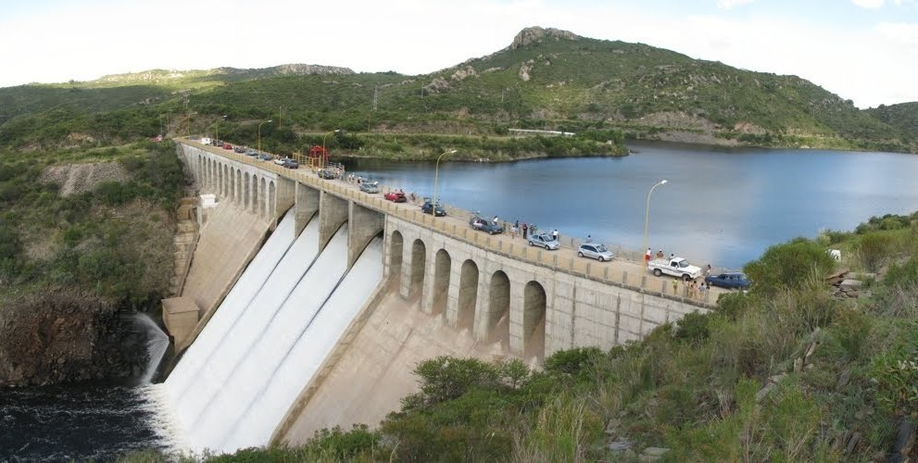
6. Retention periods
SWK should
make an assessment as to how long the reports are necessary for present and future statistic purposes and
set up a maximum retention period
ExC (clause in the contract)
- set up a maximum retention period, which is necessary for the purpose for which they were collected

Slide 10
7. Information notice
SWK does not have any contact details of the persons.
Information was not provided from the persons directly to the SWK and it would prove impossible or would involve a disproportionate effort for SWK to inform them (Art.16(5)(b) of the Proposal)
SWK is not obliged to acquire additional information in order to identify the data subject for the sole purpose of complying with the Reg (Art.12 of the Proposal); it would be disproportionate and prejudice the principle of data minimisation
However,
SWK should
- prepare an information notice referring in an intelligible, clear and plain language to all elements of Art.16 and
- publish it on its website in an easily accessible form

Slide 11
8. Personal data breach notification
SWK should ensure that there is a clause in the contract that ExC is accountable to inform SWK without undue delay
Both SWK and ExC should adopt data breach detection and reporting procedures (including mitigating potential data breach risks)
Check the impact of the breach with the ExC
Assess if the EDPS should be notified as well as the data subjects, according to the Regulation
If the EDPS has to be informed, SWK should do it no later than 72h. Notification should contain:
nature of the breach,
name and contact details of the DPO
likely consequences of the data breach
mitigating measures taken by SWK

Slide 12
8. Personal data breach notification
Inform data subjects?
« It would involve disproportionate effort » (Art.38(3(c) of the Proposal)
public communication or similar measure to inform them in an equally effective manner (e.g. note on the website)
there is no mandatory template to inform the data subjects
Keyword: document everything!!!

Slide 13
Q? A!
For more information:
www.edps.europa.eu
edps@edps.europa.eu
Subscribe to our monthly newsletter (click)

