Slide 1
ENISA IN Digital identities
and Trust Services
Rossen Naydenov
ENISA, Policy Development and Implementation Unit
IPEN Workshop, Warsaw
22
06
2022

Slide 2
aGENDA
Policy Context for ENISA
Why security of Trust Services is so important?
Overview of ENISA Activities
ENISA Vision – NEXT 3 years
Upcoming Events

Slide 3
POLICY CONTEXT FOR ENISA
ENISA mandate - CSA Article 5
Support the development and implementation of Union policy in the field of electronic identity and trust services, in particular by providing advice and issuing technical guidelines, as well as by facilitating the exchange of best practices between competent authorities
eIDAS Regulation 910/2014, Trust Services, Article 19
Support MS with supervision and security measures
Support MS with incident reporting, and cross-border notifications
Annual reports Trust services incidents
CIRAS Incident reporting and Analysis system
Future role for ENISA in the eID Cooperation network
NIS2 proposal - brings trust services under NISD
ENISA supports the NIS Cooperation group
eIDAS2 package
Proposal for eΙDAS2 - COM (2021) 281 final
Commission Recommendation on Toolbox for Digital Identity wallets
ENISA supports the EC toolbox work – technical security measures

Slide 4
WHY security of trust services is so important?
Authentication is a pillar of cybersecurity
Many other issues, like vulnerabilities and patching
But authentication and authorization will eventually become the frontline
It is not only about authenticating the end-user (phishing)
Website certificates are the cornerstone of online security
Certificate authorities are the first ‘security’ companies
A breach of the web certificates can have major impact (Diginotar)
But web certificates are often issued outside the EU and inherently hard to supervise

Slide 5
WHY security of trust services is so important?
Non-qualified certificates
Requires a close collaboration with industry, CA/Browsers Forum
Requires close collaboration with national CSIRTs and other sectors
eID and wallets are digitalization enablers in all sectors
This sector has a special role, as front runners
Digital transformation in the age of COVD19
Internet traffic in some countries increased by up to 60% shortly after the outbreak (OECD, 2020a)
Covid crisis has accelerated the digitization of customers infrastructure by 7 years
Increased the spending on data security
Remote identification and authentication on the pick

Slide 6
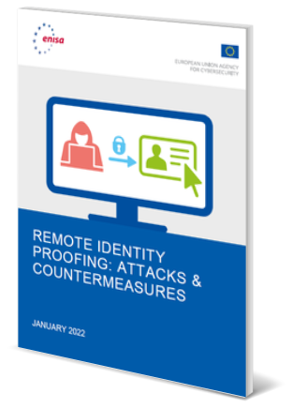
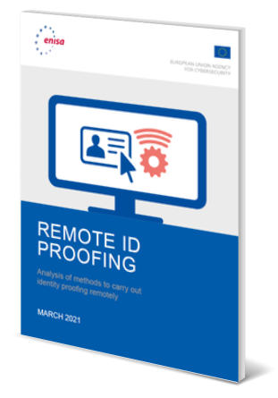
Overview of ENISA ACTIVITIES
2014 eIDAS regulation
2021 Supporting EC/MS with digital wallets
2015 ENISA Art19 EG
2016 ENISA incident tool for trust services (CIRAS)
Support MS with Trust Services
12 reports to support TSPs and SBs
5 reports to support Relying Parties
Cyber incident reporting tool, CIRAS
Secretariat of ENISA Article 19 EG
Hosting of 19 meetings of ENISA Article 19 EG since 2015
Leading role for:
ENISA Article 19 EG
CIRAS Tool – Incident reporting
ENISA TRUST SERVICES FORUM (annual conference since 2015)
Advisory role for:
Forum of European Supervisory Bodies (FESA)
Commission eIDAS expert group
eID Cooperation Network
Support MS with Digital Identity
4 reports on eID, e.g. remote identity proofing, SSI
Workshops on remote ID proofing
Participate by invitation to the eID CN
Find more under: Trust Services — ENISA (europa.eu), Building Trust in the Digital Era: ENISA boosts the uptake of the eIDAS regulation — ENISA (europa.eu)

Slide 7
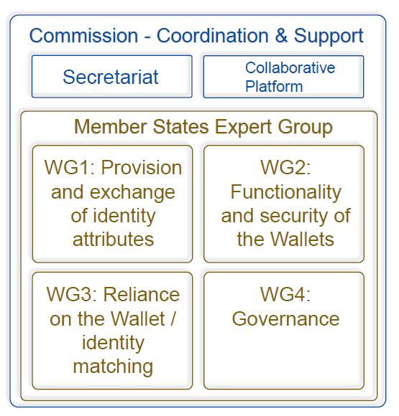
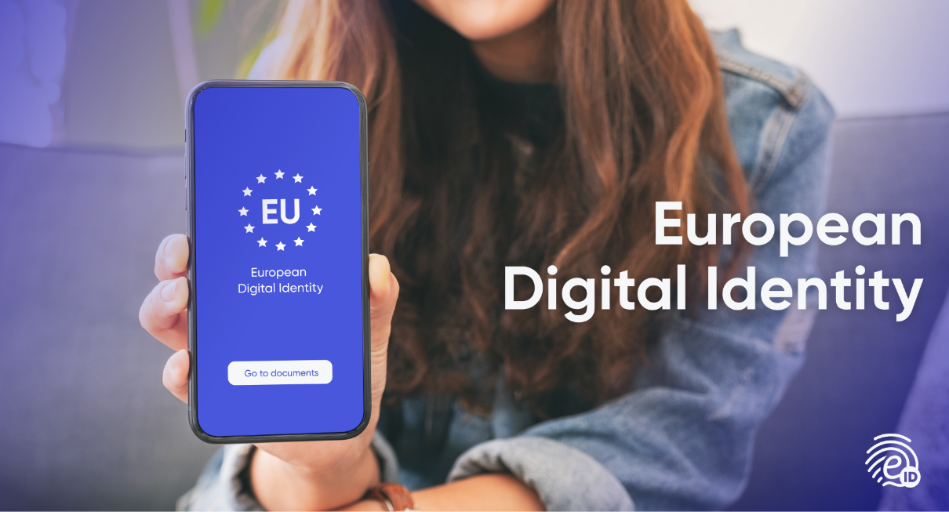
A glance INTO EU Digital wallet PROCESS
September
Agreement on Process
December
Agreement on Technical Outline
June 2022
Technical Architecture-Standards-guidelines
October 2022
Publication of ToolBox
September 2022
Agreement on ToolBox
eIDAS2
Note: Aggressive timeline – ENISA supports the MSs and the Commission

Slide 8
DIFFERENT Cybersecurity requirements
Trust services under eIDAS (and NIS2):
Assess risks and take appropriate security measures
TSPs are supervised by Supervisory Bodies (and/or NIS authorities under NIS2)
Auditing requirements for TSPs
Incident reporting to authorities
MS collaboration in the ENISA Article 19 expert group and in FESA (this will continue under the umbrella of the NISCG)
eID and wallets under eIDAS and eIDAS 2:
MS collaboration in the eID Cooperation network
eID and Digital Wallets are issued by MSs
eID are peer-reviewed by other MSs
eID incident reporting only if cross border impact
Wallet certification foreseen by CAB or under CSA
Security breach processes for eID and Digital Wallets between MS and EC is under development (ENISA is supporting)
Things in common:
Often (and increasingly) an national eID is composed of one or more trust services (e.g. ROCA)
Often cyber attacks targeting trust services are also relevant for eID schemes
In the future, an attack on an eID scheme, will have impact on TSPs (and operators in other sectors)

Slide 9
How to support the EU digital wallet process
Support the Commission with the toolbox
- Assets, Threats, Security Functions
Support CNECT.H with the legislative process
- NIS2 and EIDAS2
Seek clarity on cybersecurity standardisation requirements under the new proposal
Support the Commission in identifying the boundaries and propose ‘bridges’ across the different certification requirements; CSA addresses cybersecurity certification

Slide 10
ENISA Vision – NEXT 3 years
1. Support EU Digital identity and Digital wallet process
Support the Commission process on the Toolbox
Provide guidance on eID and wallets (support the eID CN)
2. Integrate eIDAS trust services in NIS2 and implement eIDAS2
Support the ENISA Article 19 EG (soon ECATS) of Supervisory Bodies
Synergies with FESA
Bridge with NISCG and leverage the full NIS ecosystem
3. Promote industry good practices on Trust services and eID
Build on the success of the ENISA Trust Services Forum
Identify issues, collect and develop good practices for industry
Collaborate with industry initiatives / forums / bodies

Slide 11
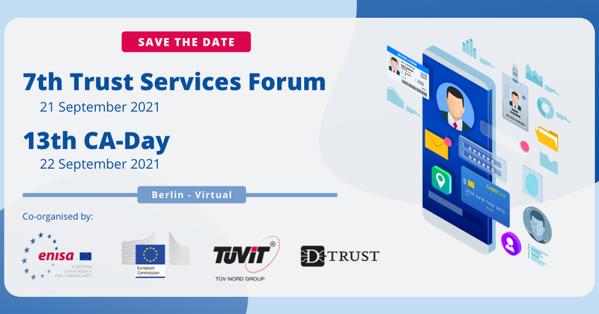
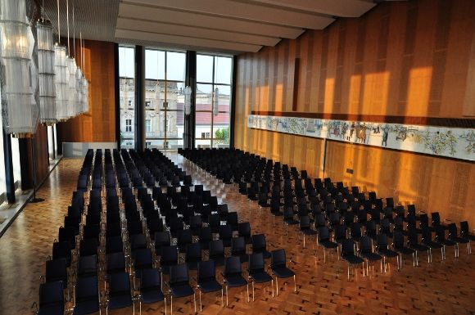
ENISA Trust Services Forum 2022
SAVE THE DATE: 27 – 28 October 2022
Berlin, ESMT
8th Trust Services Forum
27 October 2022
14th CA-Day
28 October 2022

Slide 12
Thank you! QUESTIONS?
+306956610736
eID@enisa.europa.eu
www.enisa.europe.eu

